Slide 1
Analog to digital & Digital to analog Conversion
Md. Shafqat Talukder Rakin
Lecturer, Department of CSE,
United International University
Email id : shafqat@cse.uiu.ac.bd
Courtesy: Nasif M. Sir

Slide 2
How to interface sensor with Microcontroller
A sensor is an object whose purpose is to detect events or changes in its environment, and then provide a corresponding output.
Many sensors in the real world are simple resistive devices. A photocell is a variable resistor, which produces a resistance proportional to the amount of light it senses. Other devices like flex sensors, force-sensitive resistors, and thermistors, are also variable resistors.

Slide 3
Types of Sensors
Analog sensor
Digital sensor

Slide 4
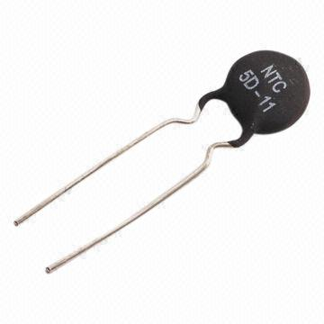
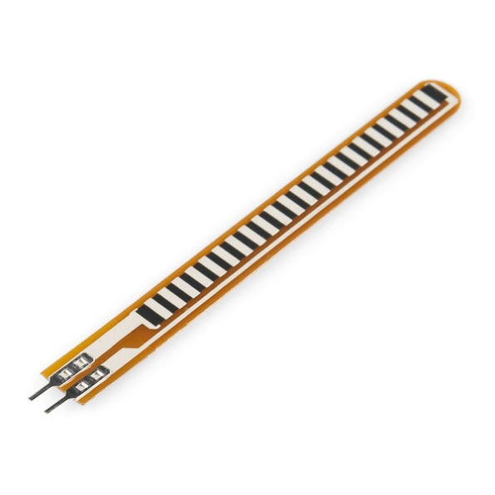
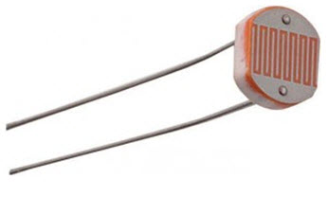
Analog Sensors
There are different types of sensors that produce continuous analog output signal and these sensors are considered as analog sensors. Practical examples of various types of analog sensors are as follows: accelerometers, pressure sensors, light sensors, sound sensors, temperature sensors, and so on.
Thermistor (temperature sensor)
LDR
(Light sensor)
Flexibility sensor

Slide 5
Analog Sensors
Pros
Usually simple sensor design
Cons
Analog signal produced by the analog sensor could be distorted during long distance transmission.

Slide 6
Digital Sensors
Electronic sensors or electrochemical sensors in which data conversion and data transmission takes place digitally are called as digital sensors. These digital sensors are replacing analog sensors as they are capable of overcoming the drawbacks of analog sensors. The digital sensor consists of majorly three components: senor, cable, and transmitter. In digital sensors, the signal measured is directly converted into digital signal output inside the digital sensor itself then this digital signal is transmitted through cable digitally.

Slide 7
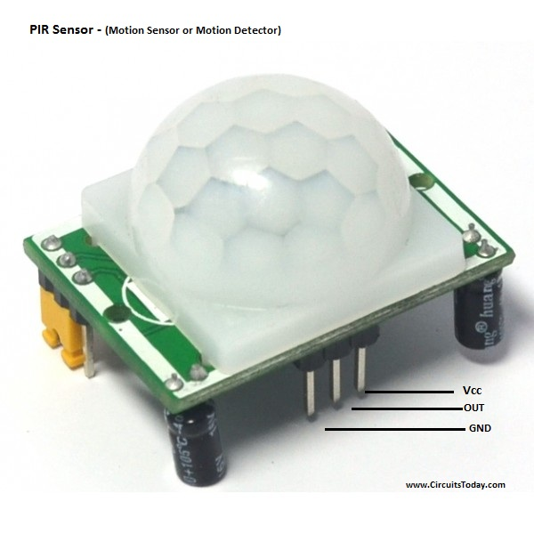
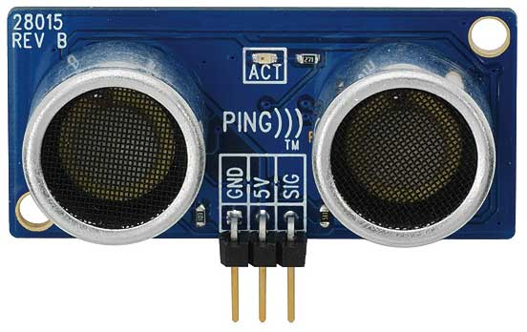
Ultrasonic sensor
PIR sensor – Motion detector sensor

Slide 8
Digital Sensors
Pros
Digital signal produced by the digital sensor could be transmitted long distance.
Cons
Usually complex sensor design.

Slide 9
LDR
Light dependent resistor (LDR) is used to detect change in light intensity or as a light sensor. LDR is basically a variable resistor.
LDR resistance changes with the change in intensity of light. If intensity of light falling on LDR is high, LDR will have low resistance.
When intensity of light decreases, LDR offer high resistance. Hence there is a inverse relationship between intensity of light and resistance of LDR.
The LDR is a resistor, and its resistance varies according to the amount of light falling on its surface.

Slide 10
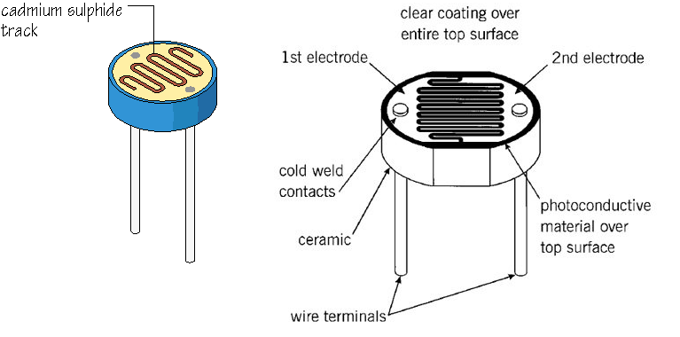
LDR
LDR

Slide 11
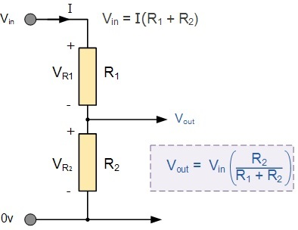
Variable Resistor R2 value change
Light Level | R₂ (Sensor) | R₁ (Fixed) | V_{out-R2}
Light | 1kΩ | 5.6kΩ | 0.76 V
Dim | 7kΩ | 5.6kΩ | 2.78 V
Dark | 10kΩ | 5.6kΩ | 3.21 V
As the light intensity increases, the resistance decrease.

Slide 12
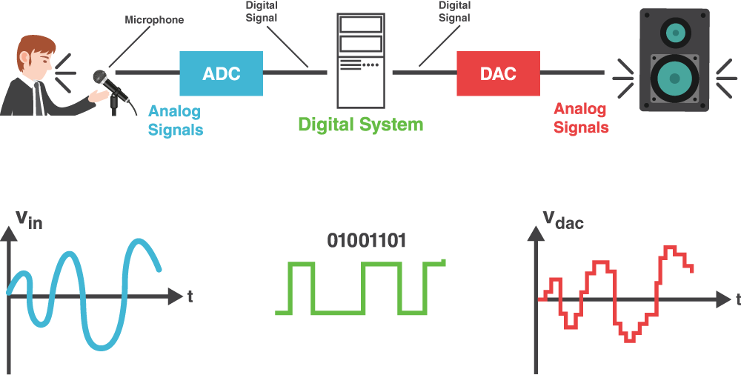
Digital communication system

Slide 13
LDR
LED
Micro-controller
Micro-controller has both ADC and DAC capability

Slide 14
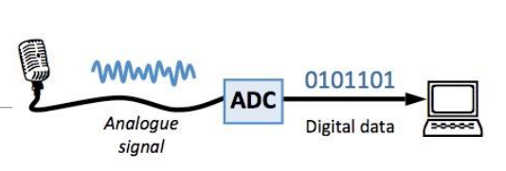
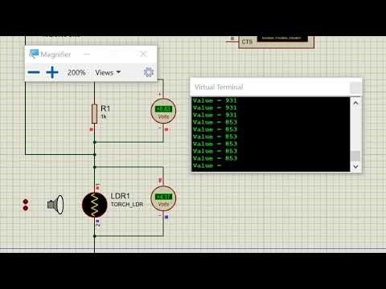
Analog-to-digital converter (ADC)
The ADC translates the analog waves of your voice into digital data that the computer can understand. To do this, it samples, or digitizes, the sound by taking precise measurements of the wave at frequent intervals.
LDR
Micro-controller

Slide 15
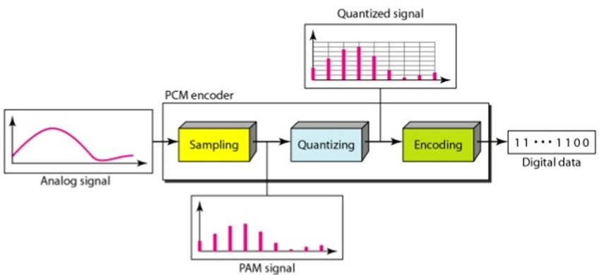
Pulse-code modulation (PCM)
The most widely used technique for digitizing information signals for electronic data transmission is pulse-code modulation (PCM). PCM signals are serial digital data.
Block diagram showing Pulse code modulation process

Slide 16
Pulse-code modulation (PCM)
Pulse-code modulation (PCM) consists of three steps:
Sampling
Quantization
Encoding

Slide 17
A. Sampling
Sample is a single measurement of amplitude.
The larger sampling rate, the better accuracy of conversion.
1010__________________________________________
1001__________________________________________
1000__________________________________________
0111_________________________________________
0110__________________________________________
0101 __________________________________________
0100 __________________________________________
0011 __________________________________________
Measurement
of amplitude
sample
Sound wave

Slide 18
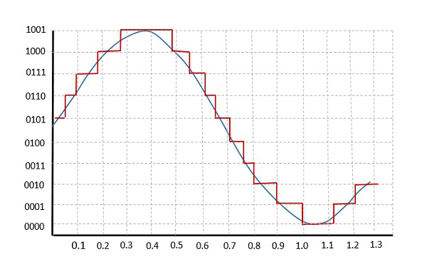
B. Quantization (1)
The quantizing of an analog signal is done by discretizing the signal with a number of quantization levels. Quantization is representing the sampled values of the amplitude by a finite set of levels, which means converting a continuous-amplitude sample into a discrete-time signal.
The figure shows how an analog signal gets quantized. The blue line represents analog signal while the brown one represents the quantized signal.

Slide 19
B. Quantization (2)
Both sampling and quantization result in the loss of information. The quality of a Quantizer output depends upon the number of quantization levels used.
The difference between an input value and its quantized value is called a Quantization Error.

Slide 20
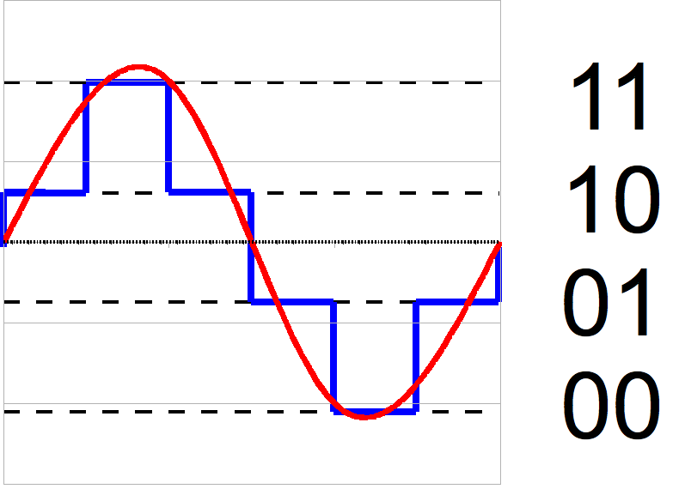
2-bit resolution with four levels of quantization
Red line: Actual signal
Blue line: Re-constructed signal

Slide 21
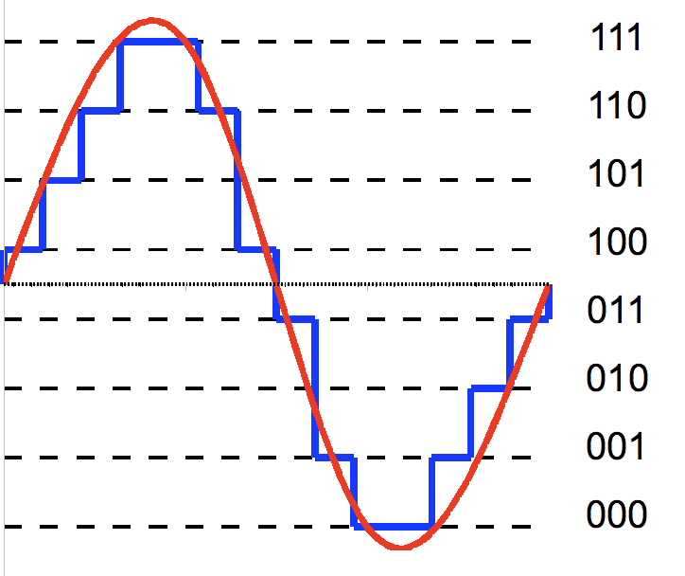
3-bit resolution with eight levels of quantization
Red line: Actual signal
Blue line: Re-constructed signal

Slide 22
C. Encoding
After the quantization process, the corresponding level is represented using binary numbers.
Encoded result: 10, 11, 11, 10, 01, 00, 00, 01

Slide 23
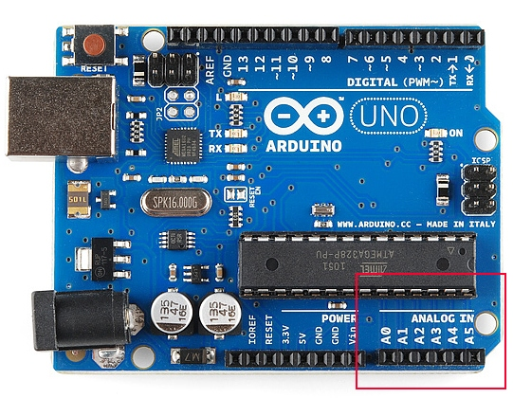
Analog pins of Arduino board

Slide 24
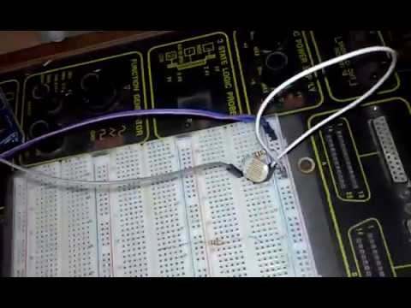
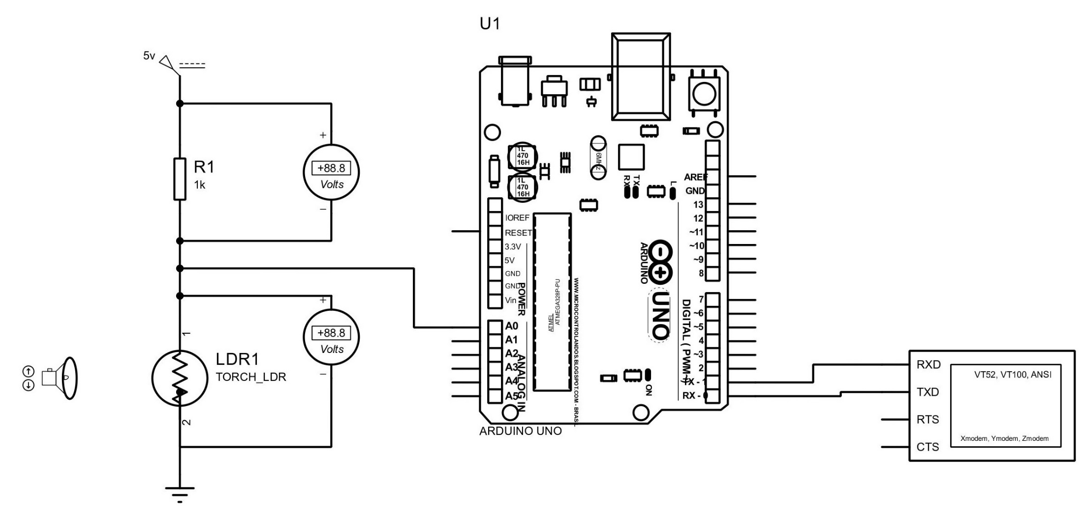
Arduino interfacing with LDR

Slide 25
Analog to digital conversion
Microcontrollers are capable of detecting binary signals: is the button pressed or not? These are digital signals. When a microcontroller is powered from five volts, it understands zero volts (0V) as a binary 0 and a five volts (5V) as a binary 1.
What if the signal is 2.72V? Is that a zero or a one? We often need to measure signals that vary; these are called analog signals.
An Analog to Digital Converter (ADC) is a very useful feature that converts an analog voltage on a pin to a digital number.
All microcontrollers have a analog to digital converter(ADC) built into them that allows us to convert these voltages into values that we can use in a program.

Slide 26
Analog to digital conversion
ADCs can vary greatly between microcontroller.
The ADC on the Arduino is a 10-bit ADC meaning it has the ability to detect 1,024 (2¹⁰) discrete analog levels. Some microcontrollers have 8-bit ADCs (2⁸ = 256 discrete levels) and some have 16-bit ADCs (2¹⁶ = 65,535 discrete levels).
The ADC reports a ratio-metric value. This means that the ADC assumes 5V is 1023 and anything less than 5V will be a ratio between 5V and 1023.

Slide 27
Relating ADC Value to Voltage
$\frac{Resolution of the ADC}{System voltage} =$ $\frac{ADC reading}{Analog voltage measured}$

Slide 28
Question
The 10-bit ADC of the Arduino on a 5V system. If the analog voltage is 2.12V then what will be the ADC report as a value?

Slide 29

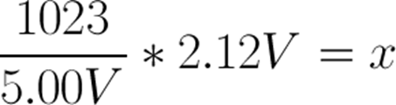
Relating ADC Value to Voltage
The ADC should report 434.
No fraction value is allowed. Take either floor or celling value.

Slide 30
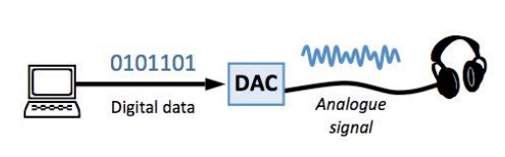
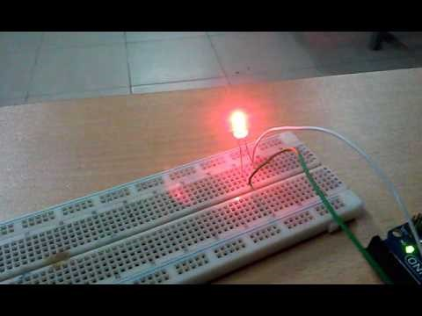
Digital-to-analog converter (DAC)
If you were to play your recording back through the speakers, the DAC would perform the same basic steps in reverse. With accurate measurements and a fast sampling rate, the restored analog signal can be nearly identical to the original sound wave.
LED
Micro-controller

Slide 31
Digital to analog
Pulse Width Modulation, or PWM, is a technique for getting digital to analog conversion.
Digital control is used to create a square wave, a signal switched between on and off. This on-off pattern (duty cycle) can simulate voltages in between full on (5 Volts) and off (0 Volts) by changing the portion of the time the signal spends on versus the time that the signal spends off. The duration of "on time" is called the pulse width.
To get varying analog values, you change, or modulate, that pulse width. If you repeat this on-off pattern fast enough with an LED for example, the result is as if the signal is a steady voltage between 0 and 5V controlling the brightness of the LED.
Arduino digital to analog resolution is 8 bit. (0-255)

Slide 32
Duty Cycle
A duty cycle is the fraction of one period in which a signal or system is active. Duty cycle is commonly expressed as a percentage or a ratio. A period is the time it takes for a signal to complete an on-and-off cycle.

Slide 33
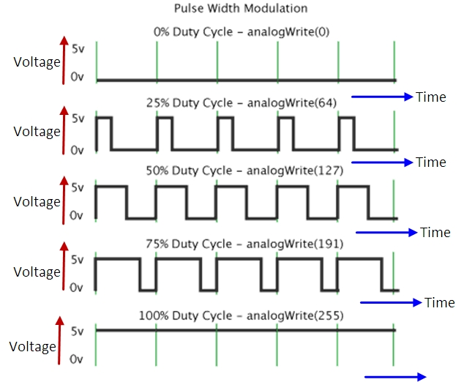
Digital to analog

Slide 34
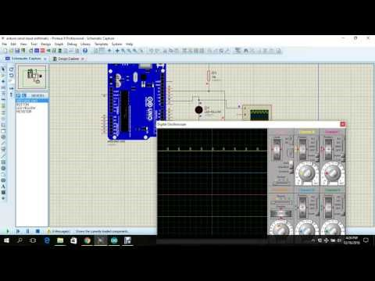
Digital to analog

Slide 35
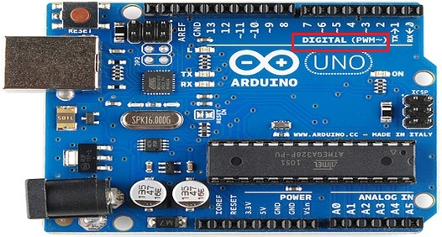
PWM supporting digital pins are: 3, 5, 6, 9, 10, 11

Slide 36
In the micro-controller, 12 bit digital to analog (DAC) resolution is set. During the digital to analog conversion programming, you have called “analogWrite (1024)” instruction. Calculate the duty cycle. Draw the duty cycle diagram. Consider system voltage is 5 V.

Slide 37
Arduino analog to digital resolution is 10 bit. (0-1023)
Arduino digital to analog resolution is 8 bit. (0-255)

Slide 38
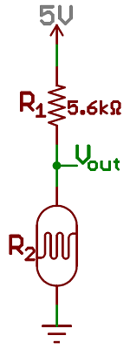
Problem
R1 = 5.6 Kohm
V= 5V
V(out) = 2.78 V
Calculate the value of R2=?

Slide 39
Reference
Voltage Divider Network
The Voltage Division Rule, allows us to use the effects of resistance proportionality to calculate the potential difference across each resistance regardless of the current flowing through the series circuit. A typical “voltage divider circuit” is shown below.

Slide 40
Thank You

